Slide 1
Google VR Head Gestures
With Black Jack

Slide 2
Gesture Based Game Using Google VR
Original Idea
3D Game in unity
Controlling Sphere Game object with Mobile Gyroscope/Accelerometer
With Game objects to avoid and collect
Hand or head gestures to move the sphere
Problems with the Idea
Phone data not streaming data correctly
A known problem with my device

Slide 3
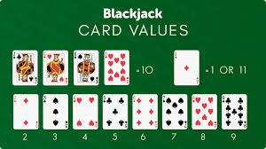
New Plan
Idea for a black jack game.
Using head gestures to control the user input.
Nodding Yes/No to stick or twist
Justification for Yes and No Head gestures
Universally Understood form of communication
Short instruction set for controls needed
Quickly becomes obvious on how to use
Balkan Countries has the opposite meaning
Other options as form of communication
Tilt head Left/Right
Look Left/Right
Look Up/Down
Reason for choosing Black Jack
The rules of stick or twist binary instructions map perfectly to yes no head gestures
Had considered a Higher or lower card game
Black Jack is more widely known

Slide 4
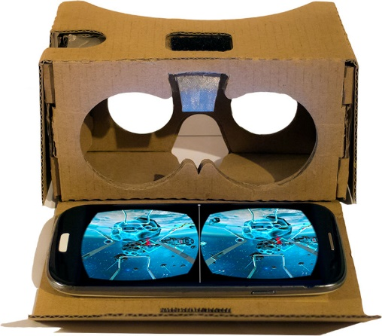
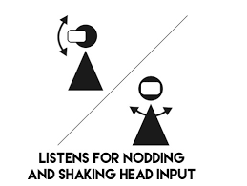
Google VR
Galaxy J6 plus mobile
Unity development package
Google cardboard/daydream
Head gesture input
Static camera Euler angle start position
Camera Euler angle based on the head position view
Using update function the current distance can be compared to the centre start position
A pre-set distance is used to control how much movement is needed to trigger a head position of up, down left or right.
Boolean values of (up && down) (left&&right)to trigger Yes\No
The Yes/No triggers are used for the twist or stick method calls

Slide 5
Black Jack
Three Game element arrays
Player (on turn push from the deck array)
The deck (pop from the deck array at every turn and start game)
The dealer (on turn push from the deck array)
Fisher yates shuffle for deck of cards
Random number between 0 – 51
Number selected place on stack
Remove selected number from
Random number between 0 – 50
Repeat until list is empty
A pdf of card deck used and split in sprite editor.
Values added to cards based on mod 13 of sprites ordering
Buttons in UI for testing (Event Handlers to map to functions)
Twist
Stick
Play again

Slide 6
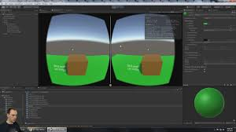
Problems while developing
No VR headset (In the post)
Tilted phone using hands
Difficult to measure head movement
Unity view incorrect when running in editor
Stereoscopic game view removed with latest update
Need phone build every time to debug
Frame rate problems (Varying degrees of nod)
Amount of head movement needed to recognise gesture
Resetting the gesture centre point changes slightly
Two yes commands being triggered

Slide 7
Demo of the game
YouTube Demo

Slide 8
Conclusion
What do I still need to do to complete the project?
Bugs
Centre position of game objects in phone view
Correct Reset Head position after yes gesture
Pros
Lots of resources
Many people had the same problems I had (with easy fixes)
Centring images and text to vr camera view
Rendering images within clipping plane of camera view
Start position of cards
Cons
Lots of setup with Android apk, Google VR and unity
Latest update has little to no backwards compatibility
Unity view different to phone build view
Spider in my VR head set

